Slide 1




Group 6 Consultancy Project
Laine Smith K24091894
Gunjun Bist K24088651
Yewon Jeong K24035489
Shangjie Deng K24027627
Selen S Ozkan K20049697

Slide 2







Table of Contents
Analysis of
Competitive Landscape
Strenghts and
Opprotunities of RBO
Market Research
Methods & Sample
Result Highlights
Primary Target Market
Secondary Target Market
Target Market Decision-Making Process
RBO’s Value Proposition
Campaign Objective
Campaign Message
Storyboard

Slide 3

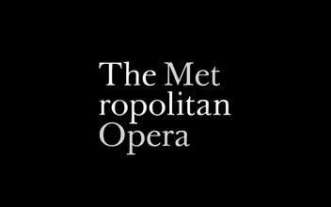
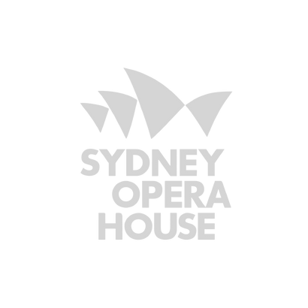

Analysis of Competitive Landscape
Category
Core Offerings | Live performances, digital content | Large-scale opera, ENO programs | Grand productions with orchestra | High-quality musicals and plays | Variety of opera, ballet, and theatre
Target Market | Primarily 45+, targeting younger audiences | Operagoers, Millennials, families | 45+, secondary focus on 18–34 | Ages 25-54, families, diverse groups | Tourists, families, local patrons
Digital Presence | Multi-tiered, discounts for students | Active on social media | HD broadcasts, online content | Social media updates | Online tours, VR, streaming
Pricing | Tiered, affordable options | Flexible, free tickets for under 21 | Tiered for all income levels | Discounts for young audiences | Tiered pricing, AUD 50-350
Revenue Model | Ticket sales, memberships, donations | Tickets, donations, subscriptions | Tickets, donations, streaming | Tickets, merchandise | Tickets, rentals, merchandise
Value Proposition | Tradition meets innovation, wider accessibility | Affordable and inclusive | Tradition with modern access | Diverse cultural hub | Local and international talent

Slide 4







Strengths
Opportunities
Premium Position & Reputation
Inclusivity
High-Quality Productions
Accessibility
Core Marketing Offerings
Cultural Diversity
Online & Offline Campaign
Brand Heritage
Digital Reach Potential
Reach Broader Audience

Slide 5
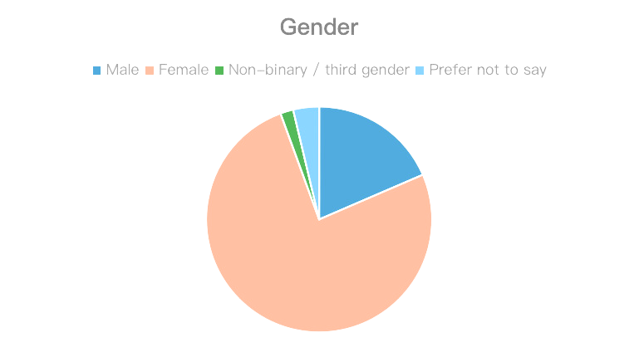
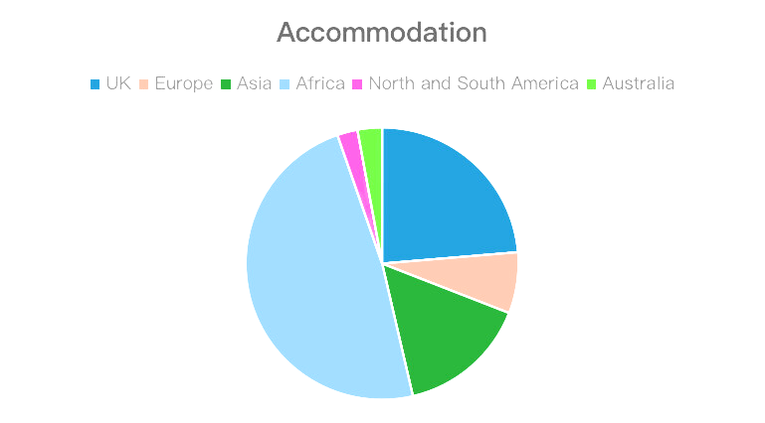
Market Research Methods & Sample
Research Methods
  Mixed-methods: Quantitative survey (Descriptive) and qualitative interviews (Exploratory).
Sampling Technique
  Non-probability convenience sampling.
Survey Sample
  108 respondents, ages 18–25, analysed by gender, accommodation, and employment status.
Interview Sample
  5 participants, ages 18–25.

Slide 6
Market Research Methods
Data Collection Methods
Research Methods
Sampling Techniques
Mixed Methods Approach
Methodology
Quantitative Research
(Descriptive)
Qualitative Research
(Exploratory)
Objectives
Research Aim
Survey
Interview
Respondents
108 respondents, ages 18–25
Respondents
5 participants, ages 18–25.

Slide 7





Result Highlights
Awareness of RBO
Highly Recognised
Key Awareness Drivers
Traditional ballet and opera performances
  Family/Friend Recommendations
  Social Media Engagement
  Metro Adverts
  Internet Browsing
Moderate Familiarity
Less Recognised
Strategic Insight
Streaming services, workshops and other initiatives
The important role of familiarity
Target digital platforms to expand awareness of under-promoted offerings.
Amongst 18-25 year olds

Slide 8

Result Highlights
Brand
Associations
Strategic Solutions
  Positive: Classic, exclusive, luxurious.
  Negative: Older, upper-class, predominantly white appeal; cultural distance.
  Appeal: Elegance, sophistication, high-quality performances.
  Barriers: High ticket prices, cultural exclusivity, lack of modern and innovation appeal.
  Cultural Inclusivity: Diverse programming, inclusive representation.
  Accessibility: Affordable tickets, alternative engagements (e.g., streaming).
  Modernisation: Blend tradition with contemporary elements.

Slide 9
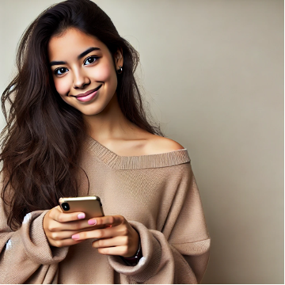




Primary Target Market
Psychographic Profile
Pain Points & Challenges
Name
Age
Gender
Origin
Location
Education
Occupation
Sofia Ramirez
21
Female
Hispanic
Madrid, Spain
Undergraduate
Part-time graphic designer
Behavioural Characteristics
Motivation & Goals

Slide 10
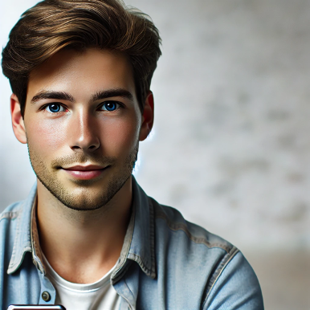
Secondary Target Market
Psychographic Profile
Pain Points & Challenges
Name
Age
Gender
Origin
Location
Education
Occupation
Daniel Turner
24
Male
Dutch
London, UK
Bachelor’s degree
Project Assistant
Behavioural Characteristics
Motivation & Goals

Slide 11
Secondary Target Market
Psychographic Profile
Pain Points & Challenges
Interests
  Community development, affordable arts, work events
Values and Beliefs
  Practicality, high-quality, accessibility.
Personality Traits
  Friendly, down-to-earth, socially conscious, hard-working
Lifestyle
  Lives on a budget, time-conscious, adventurer
  Limited Cultural Experiences
  Lack of Budget
  Value-seeking
  Percieves exclusivity in the arts
Name
Age
Gender
Origin
Location
Education
Occupation
Daniel Turner
24
Male
Dutch
London, UK
Bachelor’s degree
Project Assistant
Behavioural Characteristics
Motivation & Goals
  Discounts, flexible pricing, and low-commitment offers
  Prefers budget-friendly options
  Instagram, community newsletters, review websites, LinkedIn, Facebook, X
  Engage in accessible cultural events, explore London’s art scene within his budget.

Slide 12
Target Market Decision Making Process
Awareness
Consideration
Engagement
Post-purchase behaviour
Global Majority
Audience
Digital discovery
Instagram or TikTok
Social Influence Theory & Social proof
Inclusive and diverse content & Prospect Theory
Limited time discounts & influencer
endorsements
Social Identity Theory & User-generated content
(Kelman, 1958)
(Kahneman & Tversky, 1979)
(Tajfel & Turner, 1979)
Lower-Income
Household
Budget-friendly options
Review Websites and social media
Value-based segmentation
Cost-risk balance & Prospect Theory
Flexible choices, Testimonials,
Price-sensitivity
Social Identity Theory & Community sharing
(Kotler & Keller, 2016)
(Kahneman & Tversky, 1979)
(Monroe, 1990)
(Tajfel & Turner, 1979)

Slide 13
RBO’s value proposition
STRATEGY RECOMMENDATION
based on primary data, survey results & interview
(+) Brand perception
(+) Digital offerings
(+) Inclusivity
IMPLEMENTATION
THROUGH
Cultural integration
Creating an emotional bond
Draw younger & international viewers
Increasing cultural relevance

Slide 14

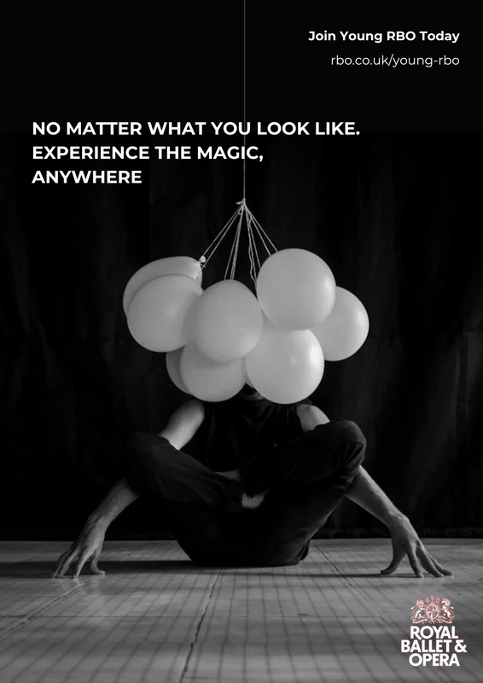






Campaign Objective
Video Campaign
Amazon Prime Ads, Netflix Ads, Cinema Ads, YouTube Ads. Promoting inclusivity and streaming platform.
Offline Campaign
Bus and underground advertisements. Cinema posters and merchandise.
Digital Campaign
Social media, including TikTok and Instagram. Influencer campaigns.
Campaign Message
Experience the magic, anywhere.
Campaign Objective
Change perception for younger audiences. Promote streaming service.
Perception of Elitism and Inaccessibility
Based on secondary data.

Slide 15
Campaign Message
Video
Social media
Offline
Large Audience
Target Audience
Local Audience
  Streaming ads
  YouTube and Cinemas
  Promotes diversity and inclusion
  Promotes streaming site
  Influencer content
  User-generated content
  Behind the Scenes
  Interviews and exclusives
  Engaging content
  Bus and undergroud
  Posters
  Located in London
  Targeting Young RBO
  Diversified campaign
“Experience the Magic, Anywhere”

Slide 16

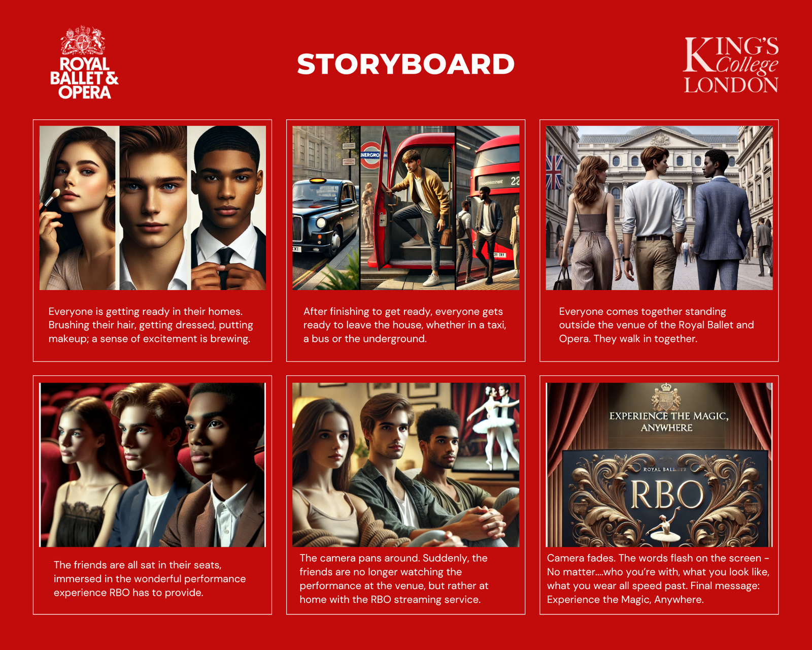

Slide 17









References:
Kelman, H. C. (1958). Compliance, identification, and internalization three processes of attitude change. Journal of Conflict Resolution, 2(1), 51-60.
Kahneman, D., & Tversky, A. (1979). Prospect theory: An analysis of decision under risk. Econometrica, 47(2), 263–291.https://doi.org/10.2307/1914185
Tajfel, H., & Turner, J. (1979). An integrative theory of inter-group conflict. In J. A. Williams & S. Worchel (Eds.), The social psychology of inter-group relations (pp. 33-47). Belmont, CA: Wadsworth.
Kotler, P., & Scheff, J. (1997). Standing Room Only: Strategies for Marketing the Performing Arts. Harvard Business School Press. Monroe, K. B. (1990). Pricing: Making profitable decisions (2nd ed.). McGraw-Hill.

