Slide 1


COPY NOTHING CAMPAIGN
Professional Presentation
by a great group

Slide 2

Traditional
CUSTOMER
Womaniser, love to show off “the type of man who would go away with his wife to a romantic hotel, spend the night flirting outrageously with a waitress, “and it’s OK because he’s got a Jaaaaaag!”

Slide 3
BUT...
Jaguar aimed to change their perception from affluent audience and instead attract younger urban, and creative demographics because they are repositioning to become fully electric and move towards a sustainable and green future.

Slide 4
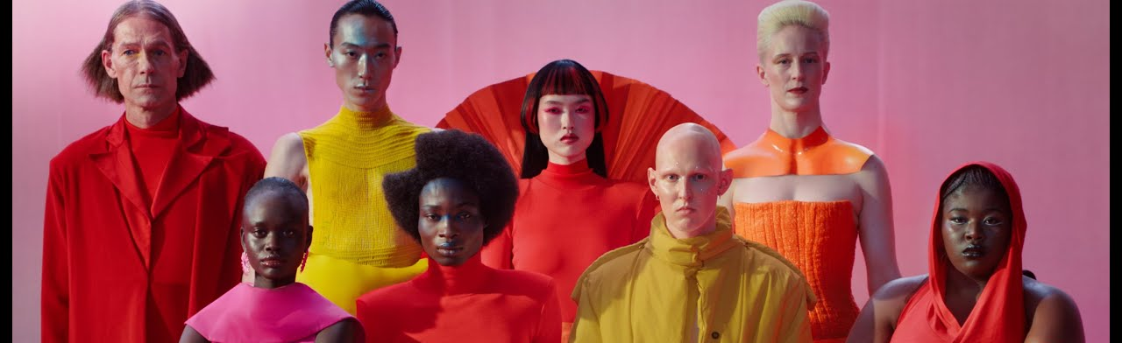

Brand
Jaguar aimed to attract new demographics and reposition their brand to becoming fully electric
GOALS
Objectives achieved with the campaign:

Slide 5


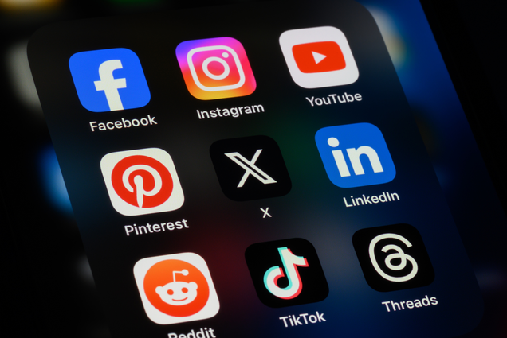
PAID MEDIA CHANNELS EMPLOYED
Social Media (Instagram, X, Facebook)
YouTube
Online News & Blogs
  Targeted ads and direct customer interaction
  High-impact video ads to boost visibility and sharing.
  Featured in automotive and lifestyle publications.

Slide 6
Earned
Types of
/
Jaguar’s post-rebrand campaign sparked widespread discussion across social media, news outlets, and forums, with viral debates and memes amplifying visibility without direct brand involvement.
MEDIA
Owned
Jaguar leveraged its official channels, including its website, social media, and YouTube, to control the narrative, showcase brand storytelling, and engage directly with its audience.
/
Shared
/
Jaguar’s Copy Nothing campaign used shared media to spark engagement through memes and debates but faced criticism for lacking cars and a modernist approach. While viral reactions boosted awareness, they also polarized audiences, showing how shared media can amplify both reach and backlash in brand repositioning.

Slide 7

Qualitative Outcomes of Jaguar's "Copy Nothing" Campaign
The campaign yielded several qualitative outcomes:
It made Jaguar a talking point, especially among younger demographics, by challenging conventions and sparking conversations about individuality and innovation14.
While some appreciated the bold and modern approach, others criticized the campaign for lacking substance and failing to clearly connect with Jaguar's heritage or its core products—luxury cars.

Slide 8

Quantitative Metrics Reported
Quantitative Outcomes & Success Assessment
  Social Media Engagement: 160M+ views in six days, surpassing past Jaguar campaigns.
  View-to-Subscriber Ratio: 8.1x, exceeding high-profile campaign benchmarks.
Assessing Success Without Sales Metrics:
  Engagement Metrics: High views and interactions signal strong interest.
  Brand Sentiment: Polarized reactions reveal shifts in perception.
  Future Opportunities: Increased visibility can support follow-up campaigns.
Conclusion: Copy Nothing generated buzz and debate but struggled to align with Jaguar’s traditional identity.

Slide 9
Contribution to
REACH AND ENGAGEMENT
160M
18-44
UCG
Targeted Demographic Engagement
Enhanced Visibility
Social Media Interaction
  Over 160 million video views in 6 days
  substantial increase in website visits from the 18–44 age demographic during the campaign period
  High level of user-generated content, shares and comments, increasing organic reach

